Slide 1
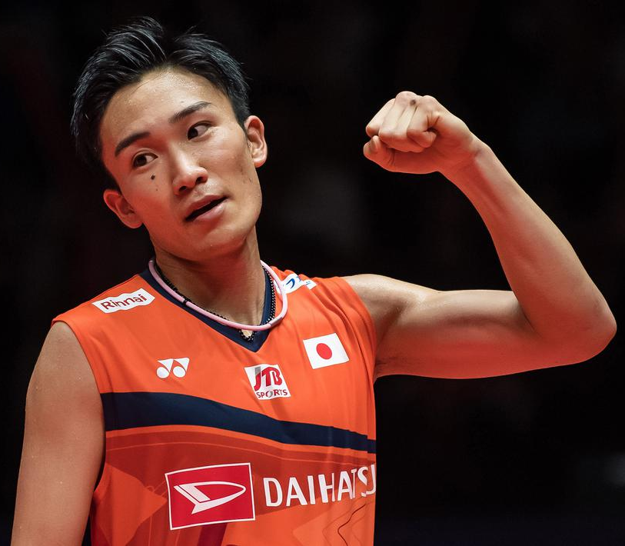
KENTO MOMOTA
Image: Bola.com

Slide 2
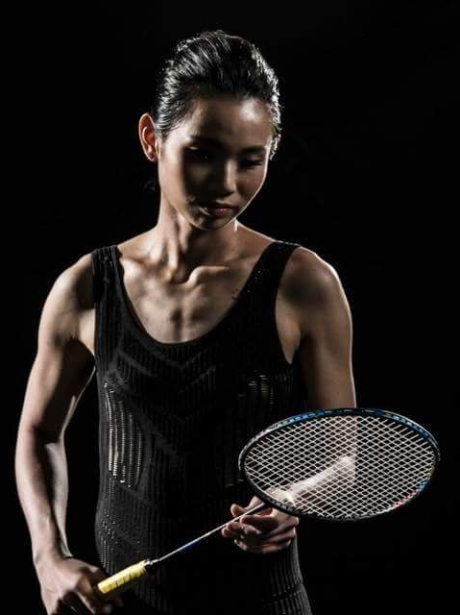
TAI TZU YING
Image: Badminton Central

Slide 3
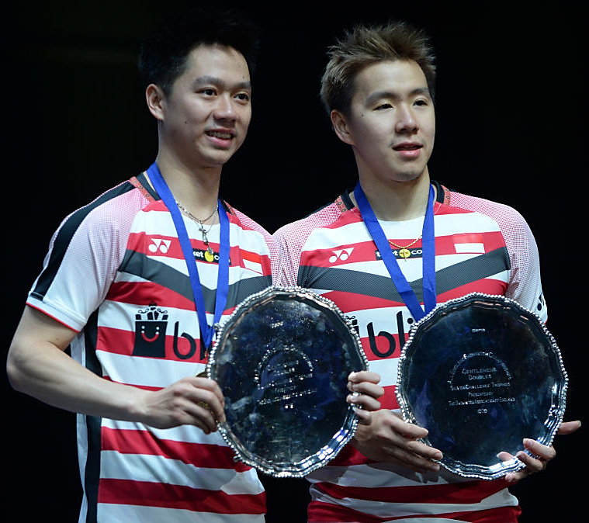
MARCUS FERNALDI GIDEON/KEVIN SANJAYA SUKAMULJO
Image: Fox Sport Asia

Slide 4
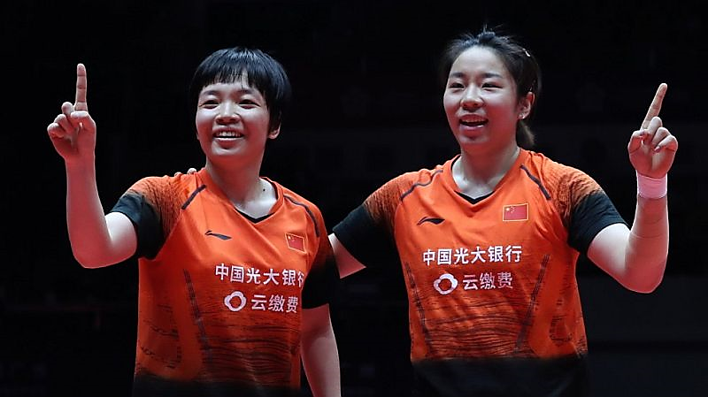
CHEN QING CHEN/JIA YI FAN
Image: BWF

Slide 5
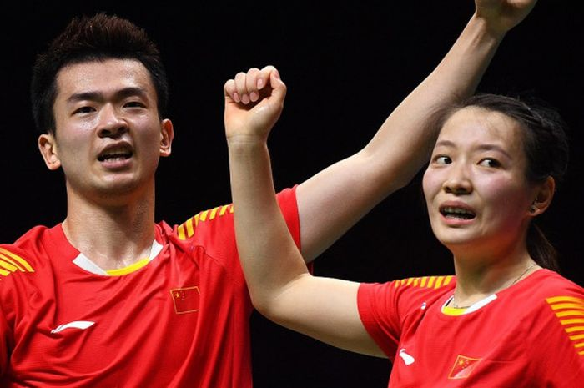
ZHENG SI WEI/HUANG YA QIONG
Image: JOHANNES EISELLE/AFP PHOTO

